Slide 1
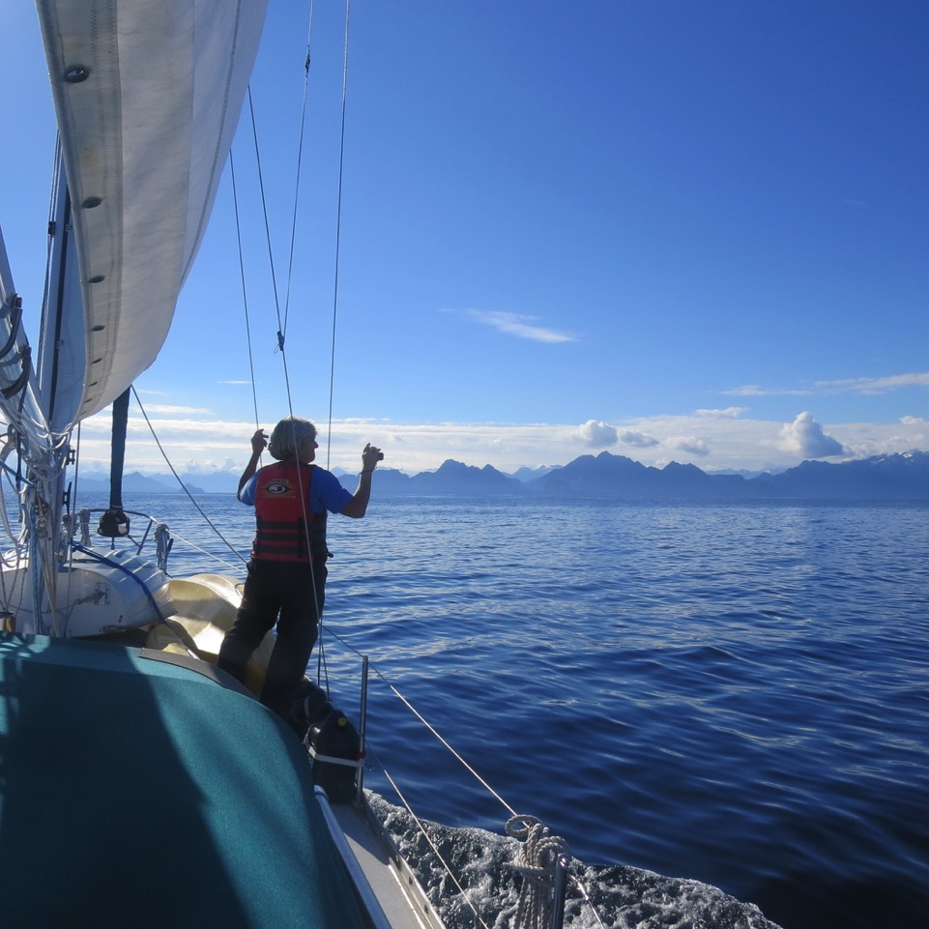
Sailing Safely Singlehanded: the Ultimate in Social Distancing

Slide 2
Basic Principles
K.I.S.S. – More gadgets don’t make you safer
Don’t rely on anything you can’t do without or fix yourself
If you can’t fix it or do without, have a backup plan
Plan for…and…practice the ‘what-ifs’
BUT….

Slide 3
Don’t let fear of failing keep you at the dock!

Slide 4
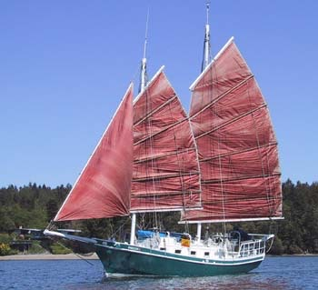
Disclaimer

Slide 5
Essentials
Autopilot (possibly also a wind vane)
Manual windlass and manual head
PC chartplotter with GPS wired to my AIS or a GPS-enabled iPad with Navionics
12 V USB charging outlets to keep backup navigation systems charged
Lazy jacks, lines led to cockpit, roller furling
SMALL refrigerator to use less power***

Slide 6
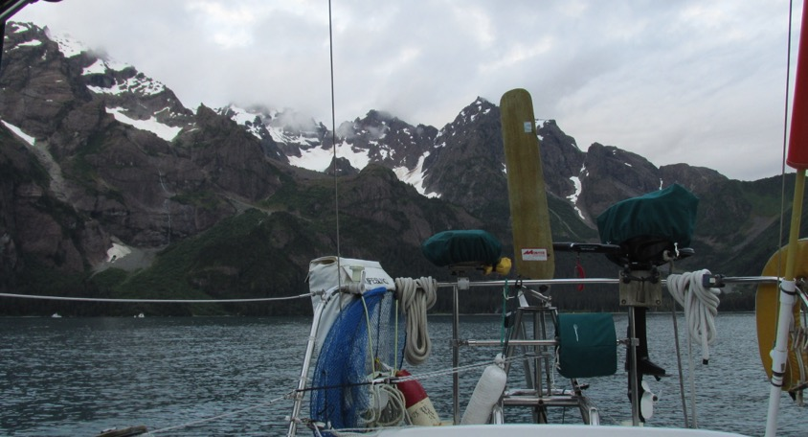
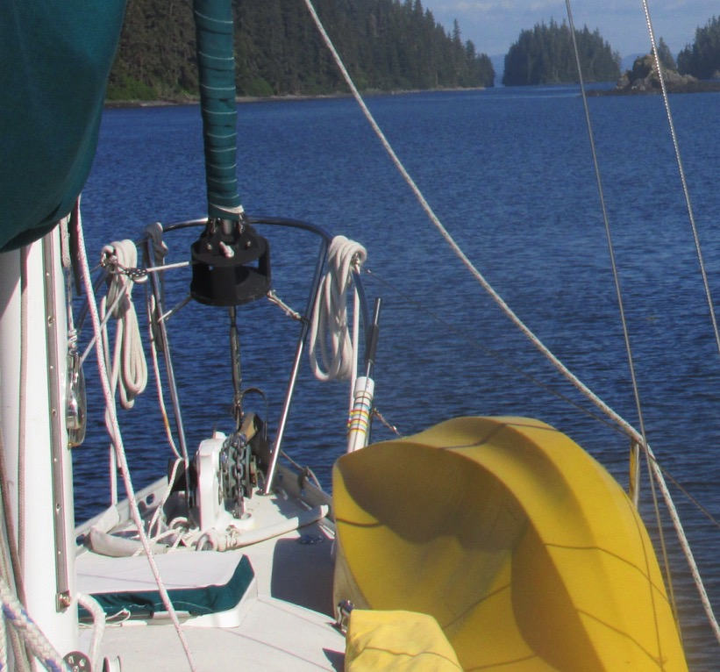
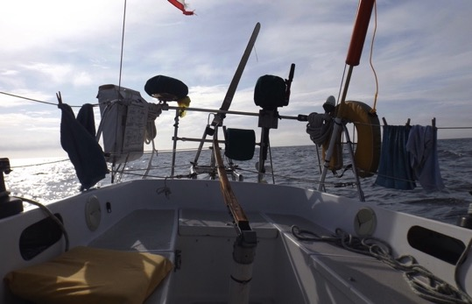

Slide 7
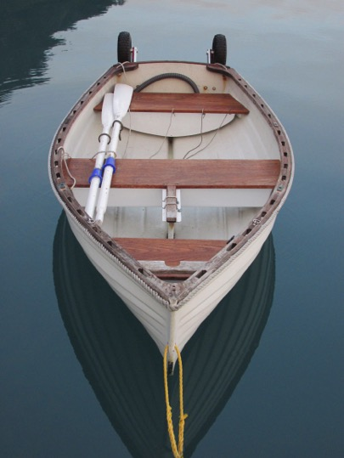
Sample Backups…
Spare ram for the autopilot
Foot pump for water
Bucket for the head
Oars for dinghy (and kayak)
Spare handle for the windlass
Separate starting battery
Hand-held radio
Spare PC plotter, iPhone
…play the ‘what-if’ game and
add to the list

Slide 8
More backups…
Spare bilge pump and manual bilge pump
Engine: starter, alternator, water pump, gaskets, belts, filters, impellers, hoses, thermostat, oil, fuel…
Anchors, rode, shackles, short pieces of line
Handles for windlass and winches
Nuts, bolts, screws, wire, fittings
Sail repair and line splicing kits
Seals, leathers, packing, etc. for your marine head
Fiberglass repair essentials
…and all the tools needed to install or repair them

Slide 9
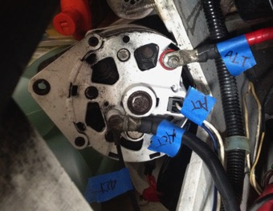
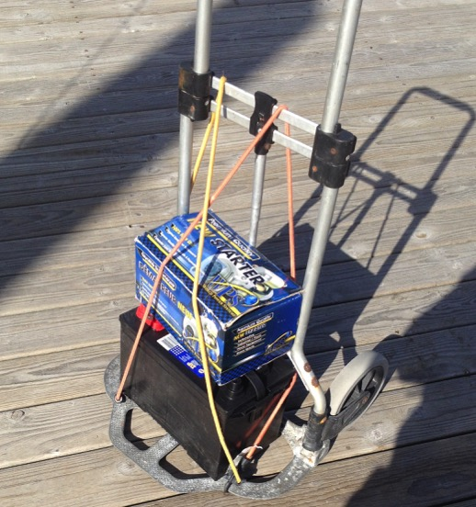
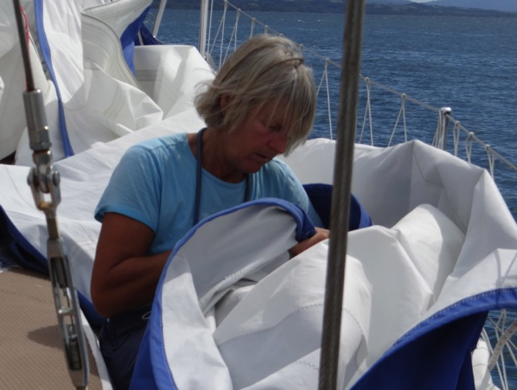

Slide 10
Prepare Yourself…
Take things apart and put them back together BEFORE you need to: windlass, winch, filters, impellers, bleed system, head, etc.
Carry PAPER manuals and repair guides, indexed by you
Learn to read the weather and interpret VHF forecasts
Understand and use mechanical advantage, blocks and tackles, running hitch, etc.
Practice heaving to, reefing, docking, anchoring, picking up a mooring, raising sail, etc.
Learn charting, navigation and rules of the road
READ about other’s lessons learned
Notes:
Tell stories about anchor windlass, fuel leak, alternator bracket,

Slide 11
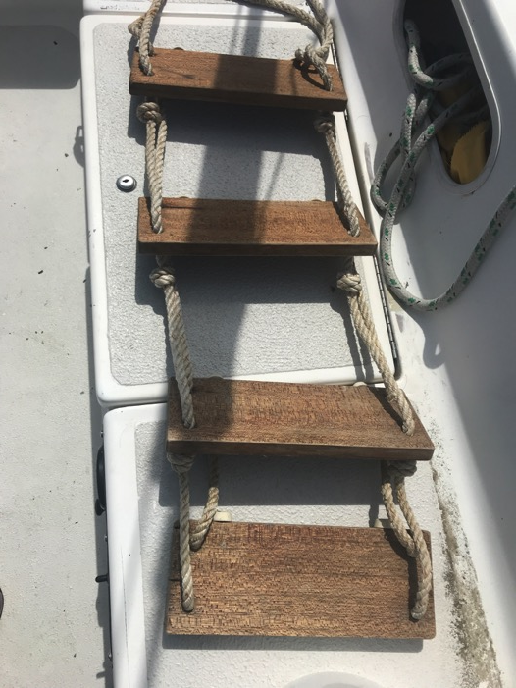
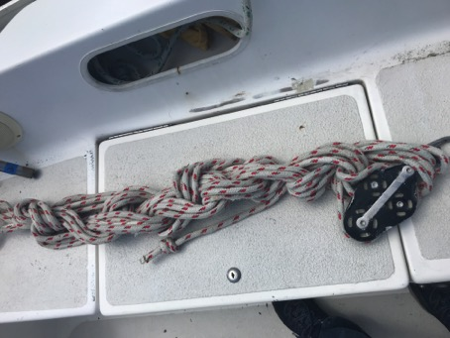

Slide 12
Plan Ahead
For long days or anticipated stretches of bad weather, cook ahead of time
Put a ladder over the side when you go kayaking
Simplify systems with an eye to being solo
Write down the weather reports for various areas as you listen
Read the cruising guide, coast pilot and chart the night before: chart your course before you leave so there are no surprises

Slide 13
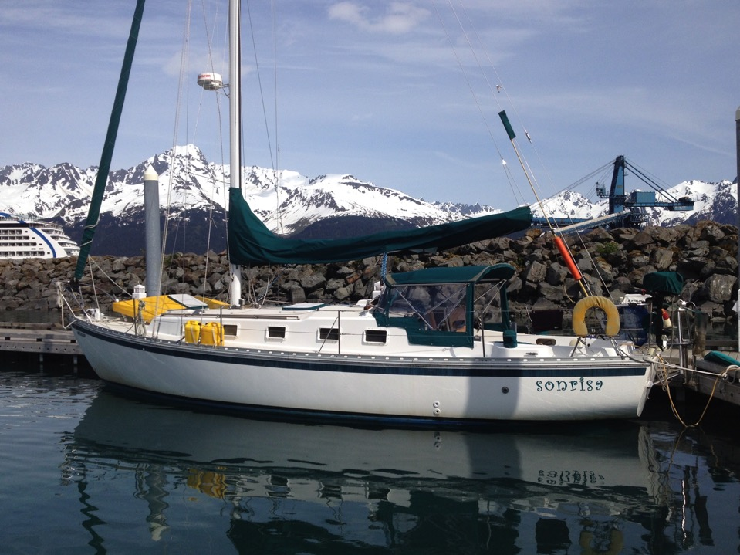
Prepare the boat

Slide 14
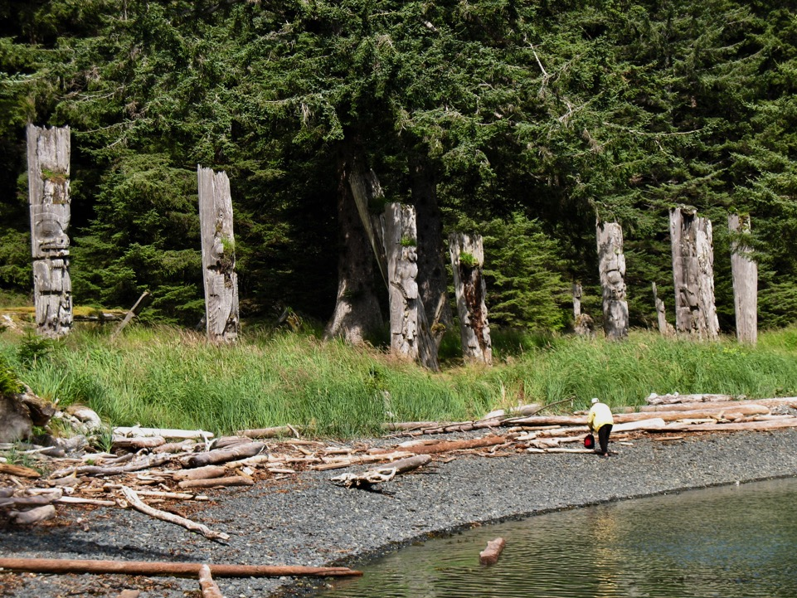
Organize boat to keep needed things close at hand
Dock lines hanked onto lifelines
Midships docking line for quick access from helm
Handle for windlass stored on deck
Lifting tackle for outboard
Clips on fenders for quick docking prep
Pockets in cockpit to keep necessaries handy
Thermos
Wetsuit, mask and plan for diving on prop
Boat organization drawings
Jack lines and pad-eyes for tethers
Stern line flaked into a plastic milk tote

Slide 15
Anchoring alone
Have anchor ready – head into wind and let boat stall as you move forward.
Drop anchor and pay out slowly as bow falls off in wind. In a stiff breeze, set anchor with the wind. In light airs, pay out chain and back down in increments
Have rode and tackle that allows you to sleep well
Anchor alarm that will wake you up
Sleep with your iPhone on the pillow

Slide 16
Staying in Touch
Learn to use the VHF – cell phones die, go overboard and lose coverage.
SPOT or INREACH device is handy on long trips
Leave a float plan with a friend – include description of boat, crew, how to contact the Coast Guard, how to contact you
VHF with DSC – CONNECT IT TO A GPS!!!

Slide 17
When S#/t Happens
Stay calm – you have more time than you think
Stay organized
Stay methodical – think before you do!
Stay put as long as you need to
Stay rested
Notes:
Tell stories about anchor windlass breaking, getting line caught in winch, fuel leak issue.

Slide 18
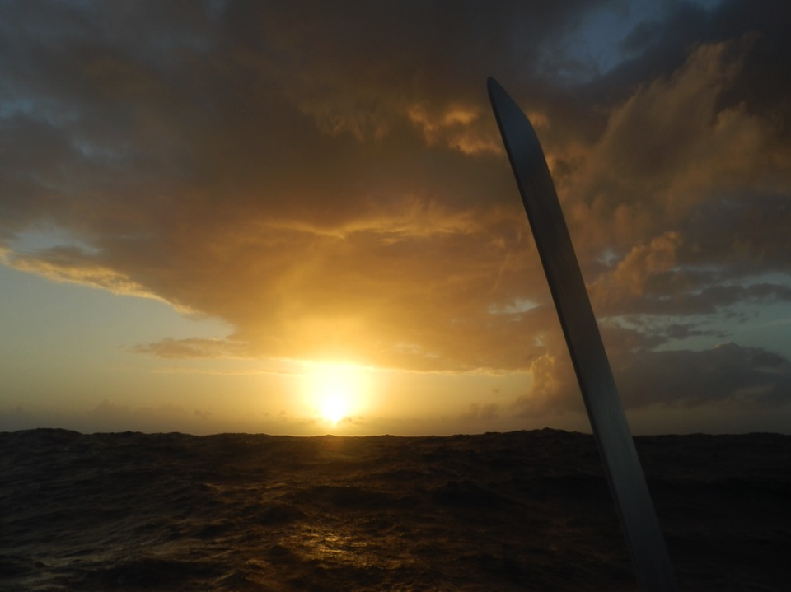
When you are out there
ALWAYS know where you are!
Remember: your autopilot is blind
Listen to your inner voice
Take care of the boat so it can take care of you
Stay rested, warm, dry, hydrated and fed
Keep things charged

